Slide 1

CSE 473: Pattern Recognition

Slide 2
Unsupervised Learning:
Clustering

Slide 3
Clustering Algorithms
2 Important distinctions: hierarchical and partitional
Partitional Clustering
  A division data objects into non-overlapping subsets (clusters) such that each data object is in exactly one subset
Hierarchical clustering
  A set of nested clusters organized as a hierarchical tree

Slide 4

Partitional Clustering
Original Points
A Partitional Clustering

Slide 5
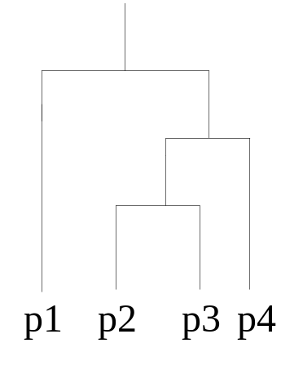
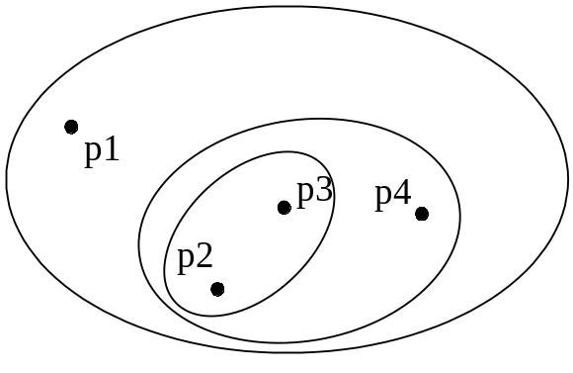
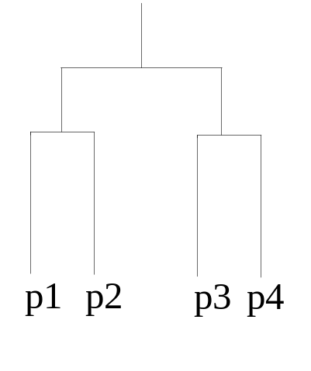
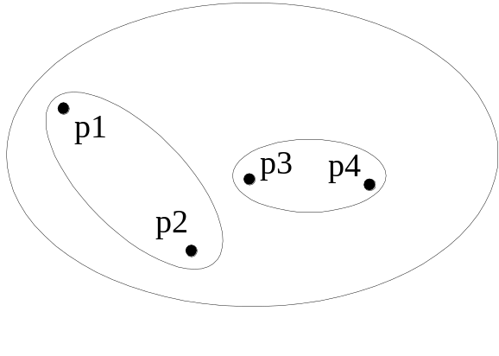
Hierarchical Clustering
Traditional Hierarchical Clustering
Traditional Dendrogram
Non-traditional Hierarchical Clustering
Non-traditional Dendrogram

Slide 6
Hierarchical Clustering
Hierarchical: A sequence of (nested) clusterings is produced.
  Agglomerative
  Divisive
  Combinations of the above (e.g., the Chameleon algorithm.)

Slide 7
OTHER MAJOR CATEGORIES OF CLUSTERING ALGORITHMS
Sequential: A single clustering is produced. One or few sequential passes on the data.

Slide 8
Cost function optimization. For most of the cases a
single clustering is obtained.
  Hard clustering (each point belongs exclusively to a single cluster):
    Basic hard clustering algorithms (e.g., k-means)
    Branch and bound
    Boundary detection
    Genetic clustering algorithms
    …
    ..
    .
  Fuzzy clustering (each point belongs to more than one clusters simultaneously).
  Probabilistic clustering (it is based on the probability of a point to belong to a cluster).

Slide 9
Other schemes:
  Exclusive versus non-exclusive
    In non-exclusive clusterings, points may belong to multiple clusters.
    Can represent multiple classes or ‘border’ points
  Partial versus complete
    In some cases, we only want to cluster some of the data
  Heterogeneous versus homogeneous
    Cluster of widely different sizes, shapes, and densities

Slide 10
Other schemes:
  Algorithms based on graph theory (e.g., Minimum Spanning Tree, regions of influence, directed trees).
  Density based clustering algorithms.
  Subspace clustering algorithms.
  Kernel based methods

Slide 11
Clustering and Clusters :Difference?
Types of Clusters
Well-separated clusters
Center-based clusters
Contiguous clusters
Density-based clusters
Property or Conceptual
Described by an Objective Function

Slide 12
Types of Clusters: Well-Separated
Well-Separated Clusters:
  A cluster is a set of points such that any point in a cluster is closer (or more similar) to every other point in the cluster than to any point not in the cluster.
B
A
C
3 well-separated clusters

Slide 13
Types of Clusters: Center-Based
Center-based
  A cluster is a set of objects such that an object in a cluster is closer (more similar) to the “center” of a cluster, than to the center of any other cluster
  The center of a cluster is often a centroid, the average of all the points in the cluster, or a medoid, the most “representative” point of a cluster
A
C₂
C₁
4 center-based clusters

Slide 14
Types of Clusters: Contiguity-Based
Contiguous Cluster (Nearest neighbor or Transitive)
  A cluster is a set of points such that a point in a cluster is closer (or more similar) to one or more other points in the cluster than to any point not in the cluster.
8 contiguous clusters

Slide 15
Types of Clusters: Density-Based
Density-based
  A cluster is a dense region of points, which is separated by low-density regions, from other regions of high density.
  Used when the clusters are irregular or intertwined, and when noise and outliers are present.
Area of low density
Area of high density
6 density-based clusters

Slide 16
Types of Clusters: Conceptual Clusters
Shared Property or Conceptual Clusters
  Finds clusters that share some common property or represent a particular concept.
2 Overlapping Circles

Slide 17
SEQUENTIAL CLUSTERING ALGORITHMS
Characteristics:
  One or very few passes on the data
  No a-prior knowledge about the number of clusters
  The clusters are defined with the aid of
    An appropriately defined distance d (x,C) of a point from a cluster.
    A threshold Θ associated with the distance.

Slide 18
Basic Sequential Clustering Algorithm (BSAS)
  m=1 \ {number of clusters}\
  C_{m}={x₁}
  For i=2 to N
    Find C_{k}: d(x_{i},C_{k})=min_{1≤j≤m}d(x_{i},C_{j})
    If (d(x_{i},C_{k})>Θ) AND (m<q) then
      m=m+1
      C_{m}={x_{i}}
    Else
      C_{k}=C_{k}∪{x_{i}}
      Where necessary, update representatives (*)
    End {if}
  End {for}

Slide 19
Basic Sequential Clustering Algorithm (BSAS)
  m=1 \{number of clusters}\
  C_{m}={x₁}
  For i=2 to N
    Find C_{k}: d(x_{i},C_{k})=min_{1≤j≤m}d(x_{i},C_{j})
    If (d(x_{i},C_{k})>Θ) AND (m<q) then
      m=m+1
      C_{m}={x_{i}}
    Else
      C_{k}=C_{k}∪{x_{i}}
      Where necessary, update representatives (*)
    End {if}
  End {for}
(*) When the mean vector m_{C} is used as representative of the cluster C with n_{c} elements, the updating in the light of a new vector x becomes
m_{C}^{new}=(n_{C} m_{C} + x) / (n_{C}+1)

Slide 20
Remarks:
  The order of presentation of the data in the algorithm plays important role in the clustering results.
    Different order of presentation may lead to totally different clustering results

Slide 21
Remarks:
  The order of presentation of the data in the algorithm plays important role in the clustering results.
    Different order of presentation may lead to totally different clustering results
  In BSAS the decision for a vector x is reached prior to the final cluster formation.

Slide 22
Remarks:
  The order of presentation of the data in the algorithm plays important role in the clustering results.
    Different order of presentation may lead to totally different clustering results
  In BSAS the decision for a vector x is reached prior to the final cluster formation.
  BSAS perform a single pass on the data. Its complexity is O(N).

Slide 23
Estimating the number of clusters in the data set:
25
15
5
-5
-5
5
15
25
Θ

Slide 24
Estimating the number of clusters in the data set:
Let BSAS(Θ) denote the BSAS algorithm when the dissimilarity threshold is Θ.
  Find
    a, the maximum and
    b, the minimum distances among the points
25
15
5
-5
-5
5
15
25

Slide 25
Estimating the number of clusters in the data set:
Let BSAS(Θ) denote the BSAS algorithm when the dissimilarity threshold is Θ.
  For Θ=a to b step c
    Run s times BSAS(Θ), each time presenting the data in a different order.
    Estimate the number of clusters m_{Θ}, as the most frequent number resulting from the s runs of BSAS(Θ).
  Next Θ
25
15
5
-5
-5
5
15
25

Slide 26
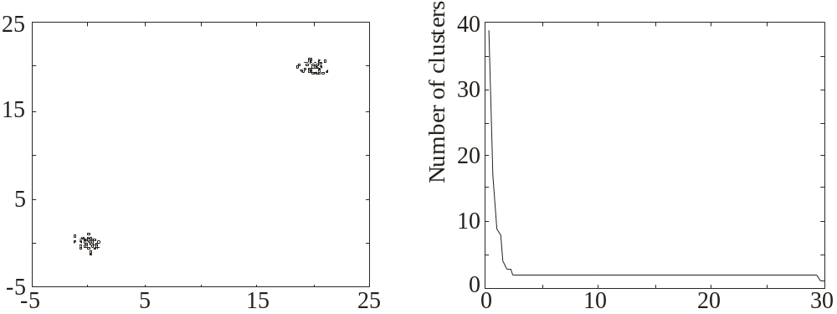
Estimating the number of clusters in the data set:
Let BSAS(Θ) denote the BSAS algorithm when the dissimilarity threshold is Θ.
  For Θ=a to b step c
    Run s times BSAS(Θ), each time presenting the data in a different order.
    Estimate the number of clusters m_{Θ}, as the most frequent number resulting from the s runs of BSAS(Θ).
  Next Θ
  Plot m_{Θ} versus Θ and identify the number of clusters m as the one corresponding to the widest flat region in the above graph.
Θ

Slide 27
MBSAS, a modification of BSAS
In BSAS a decision for a data vector x is reached prior to the final cluster formation, which is determined after all vectors have been presented to the algorithm.

Slide 28
MBSAS, a modification of BSAS
In BSAS a decision for a data vector x is reached prior to the final cluster formation, which is determined after all vectors have been presented to the algorithm.
  MBSAS deals with the above drawback, at the cost of presenting the data twice to the algorithm.

Slide 29
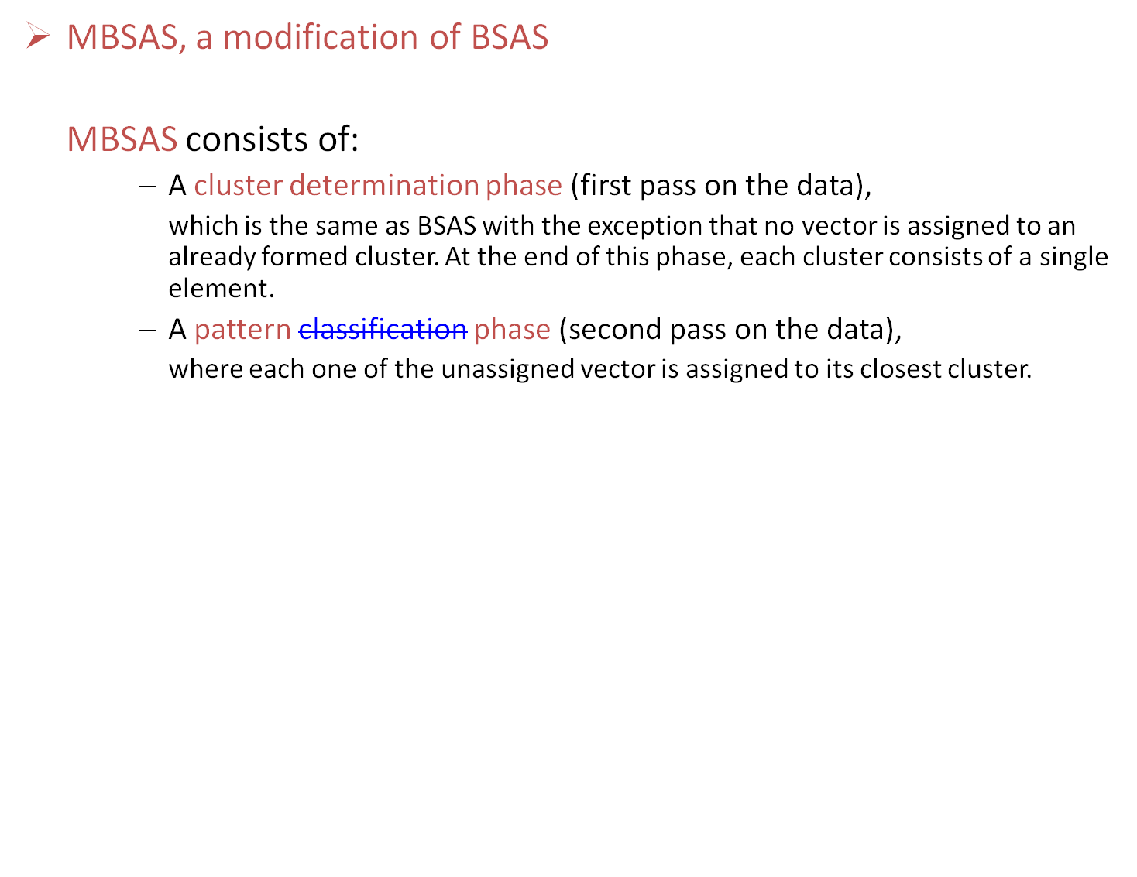

Slide 30
MBSAS, a modification of BSAS
Cluster Determination
  m=1 \ {number of clusters}\
  C_{m}={x₁}
  For i=2 to N
    Find C_{k}: d(x_{i},C_{k})=min_{1≤j≤m}d(x_{i},C_{j})
    If (d(x_{i},C_{k})>Θ) AND (m<q) then
      m=m+1
      C_{m}={x_{i}}
    End {if}
  End {for}

Slide 31
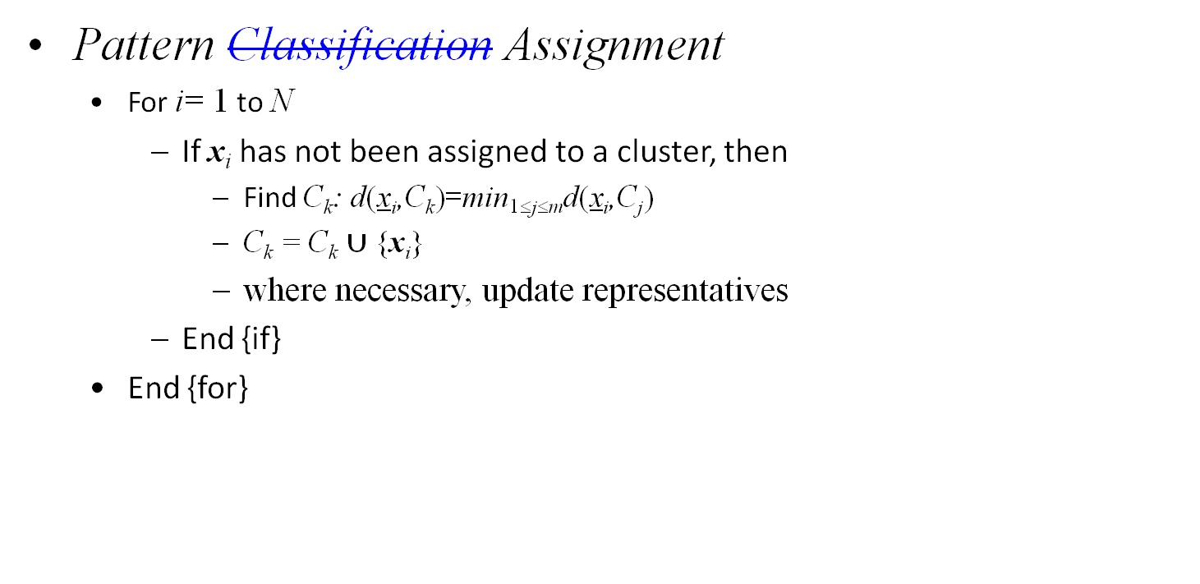
MBSAS, a modification of BSAS

Slide 32
MBSAS, a modification of BSAS
Remarks:
  decision for a vector x during the pattern classification phase is reached taking into account all clusters.
  still sensitive to the order of presentation of the vectors.
  requires two passes on the data. complexity is O(N).

Slide 33
The maxmin algorithm, a variant of MBSAS
Let X= the set of all data points
W = the set of all points that have been chosen to form clusters up to the current iteration step.

Slide 34
The maxmin algorithm, a variant of MBSAS
cluster formation:
    For each x∈X-W determine d_{x}=min_{z∈W} d(x,z)
    Determine y: d_{y}=max_{x∈X-W}d_{x}
    If d_{y} is greater than a pre-specified threshold then
      this vector forms a new cluster
    else
      the cluster determination phase of the algorithm terminates.
    End {if}
pattern classification:
assign each unassigned vector to its closest cluster

Slide 35
Remarks:
  The maxmin algorithm is more computationally demanding than MBSAS.
  However, it is expected to produce better clustering results.

Slide 36
A two-threshold sequential scheme (TTSAS)
  The formation of the clusters, as well as the assignment of vectors to clusters, is carried out concurrently (like BSAS and unlike MBSAS)
  Two thresholds Θ₁ and Θ₂ (Θ₁<Θ₂) are employed

Slide 37
A two-threshold sequential scheme (TTSAS)
  The general idea is the following:
    If the distance d(x,C) of x from its closest cluster, C, is greater than Θ₂ then:
      A new cluster represented by x is formed.
    Else if d(x,C)<Θ₁ then
      x is assigned to C.
    Else
      The decision is postponed to a later stage.
    End {if}

Slide 38
A two-threshold sequential scheme (TTSAS)
  The general idea is the following:
    If the distance d(x,C) of x from its closest cluster, C, is greater than Θ₂ then:
      A new cluster represented by x is formed.
    Else if d(x,C)<Θ₁ then
      x is assigned to C.
    Else
      The decision is postponed to a later stage.
    End {if}
The unassigned vectors are presented iteratively to the algorithm
until all of them are classified.

Slide 39
Remarks:
  In practice, a few passes (≥2) of the data set are required.
  TTSAS is less sensitive to the order of data presentation, compared to BSAS.

Slide 40
Refinement stages
Why necessary?
The problem of closeness of clusters: “In all the above algorithms it may happen that two formed clusters lie very close to each other”.

Slide 41
Refinement stages
  A simple merging procedure
    (A) Find C_{i}, C_{j} (i<j) such that d(C_{i},C_{j})=min_{k,r=1,…,m,k≠r}d(C_{k},C_{r})
    If d(C_{i},C_{j})≤M₁ then \{ M₁ is a user-defined threshold \}
      Merge C_{i}, C_{j} to C_{i} and eliminate C_{j} .
      If necessary, update the cluster representative of C_{i} .
      Rename the clusters C_{j+1},…,C_{m} to C_{j},…,C_{m-1}, respectively.
      m=m-1
      Go to (A)
    Else
      Stop
    End {if}

Slide 42
Reassignment of vectors
Why necessary?
The problem of sensitivity to the order of data presentation:
“A vector x may have been assigned to a cluster C_{i} at the current stage but another cluster C_{j} may be formed at a later stage that lies closer to x”

Slide 43
  A simple reassignment procedure
    For i=1 to N
      Find C_{j} such that d(x_{i},C_{j})=min_{k=1,…,m}d(x_{i},C_{k})
      Set b(i)=j \{ b(i) is the index of the cluster that lies closet to x_{i} \}
    End {for}
    For j=1 to m
      Set C_{j}={x_{i}∈X: b(i)=j}
      If necessary, update representatives
    End {for}

Slide 44
K-means Clustering
Partitional clustering approach
Each cluster is associated with a centroid (center point)
Each point is assigned to the cluster with the closest centroid
Number of clusters, K, must be specified
The basic algorithm is very simple

Slide 45

K-means Clustering
Partitional clustering approach
Each cluster is associated with a centroid (center point)
Each point is assigned to the cluster with the closest centroid
Number of clusters, K, must be specified
The basic algorithm is very simple

Slide 46
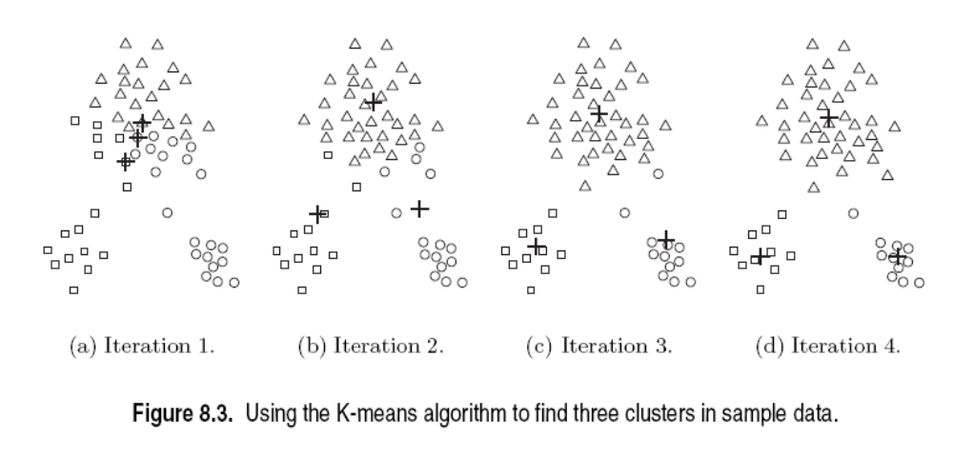
K-means Clustering
Initial centroids are often chosen randomly.
  Clusters produced vary from one run to another.

Slide 47
K-means Clustering
Points are distributed to the closest centroid.
‘Closeness’ is measured by Euclidean distance, cosine similarity, correlation, etc.

Slide 48
K-means Clustering
centroid is (typically) the mean of the points in the cluster.

Slide 49
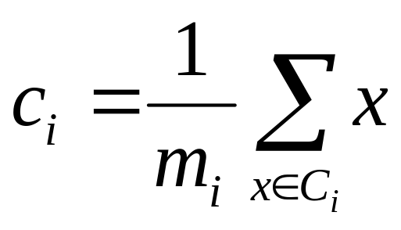
K-means Clustering
centroid is (typically) the mean of the points in the cluster.

Slide 50
K-means Clustering
K-means will converge for common similarity measures

Slide 51
K-means Clustering
Most of the convergence happens in the first few iterations.
  Often the stopping condition is changed to ‘Until relatively few points change clusters’

Slide 52
K-means Clustering

Slide 53
K-means Clustering
k-means try to optimize an objective function

Slide 54
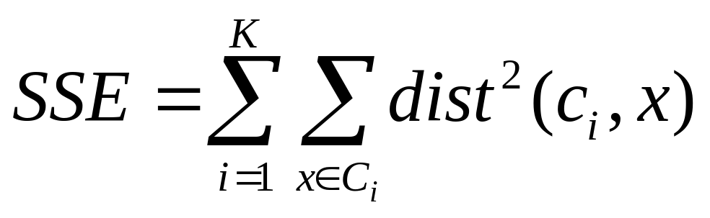
K-means Clustering
k-means try to optimize an objective function

Slide 55
Evaluating K-means Clusters
  Given two clusters, choose the one with the smallest error
  easy way to reduce SSE is to increase K
    A good clustering with smaller K can have a lower SSE than a poor clustering with higher K

Slide 56
K-means Clustering – Complexity
Storage Complexity is O ((m+K)n)
  m = number of points
  K = number of clusters
  n = number of attributes
Time Complexity is O(I* K * m *n )
  I = number of iterations

Slide 57



K-means may lead to suboptimal solution
Original Points
Optimal Clustering
Sub-optimal Clustering

Slide 58






Importance of Choosing Initial Centroids

Slide 59
Importance of Choosing Initial Centroids
find optimal SSE, although initial centroids are from one natural cluster

Slide 60
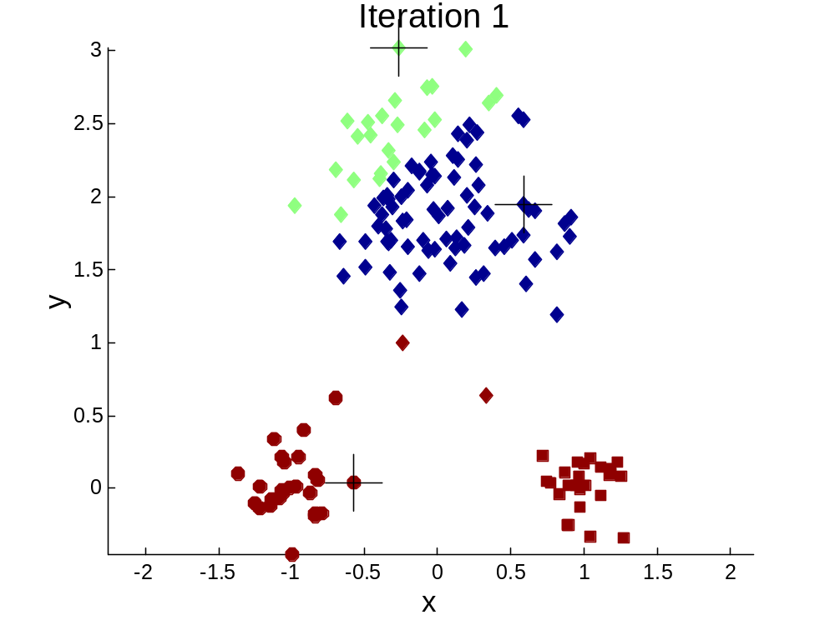


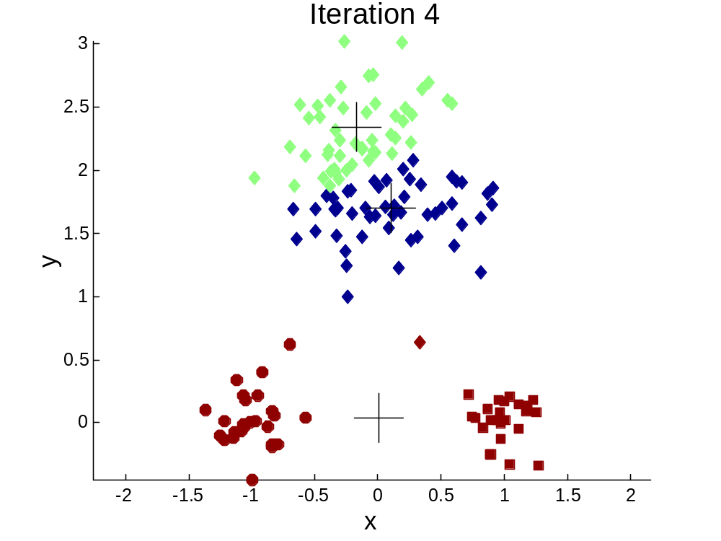
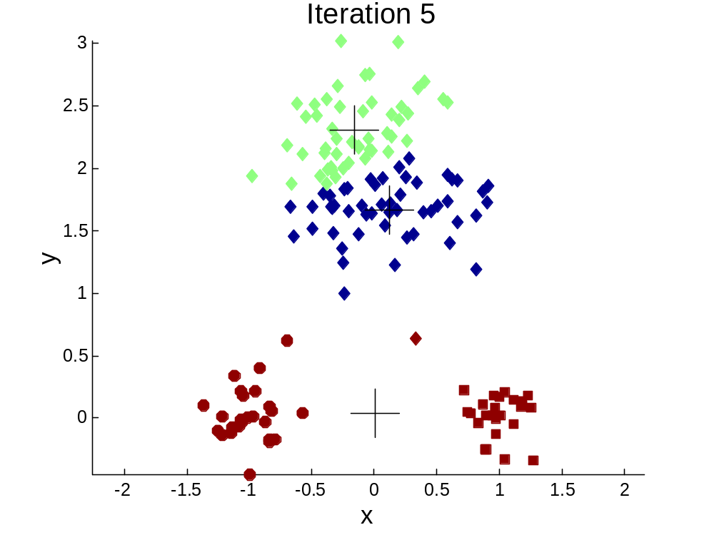
Importance of Choosing Initial Centroids …

Slide 61
Importance of Choosing Initial Centroids …
cannot find optimal SSE

Slide 62
Problems with Selecting Initial Points
If there are K ‘real’ clusters then the chance of selecting one centroid from each cluster is small.
  Chance is relatively small when K is large
  Consider an example of five pairs of clusters

Slide 63
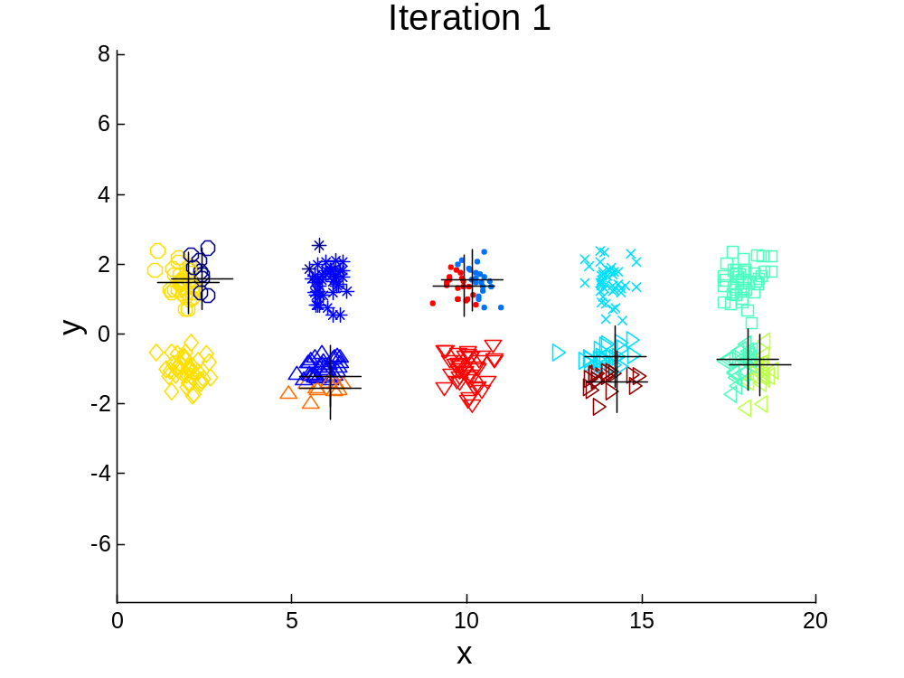
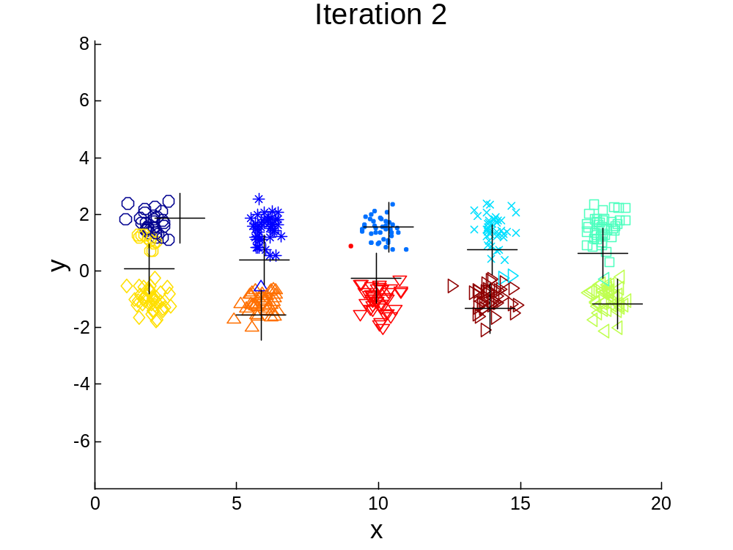
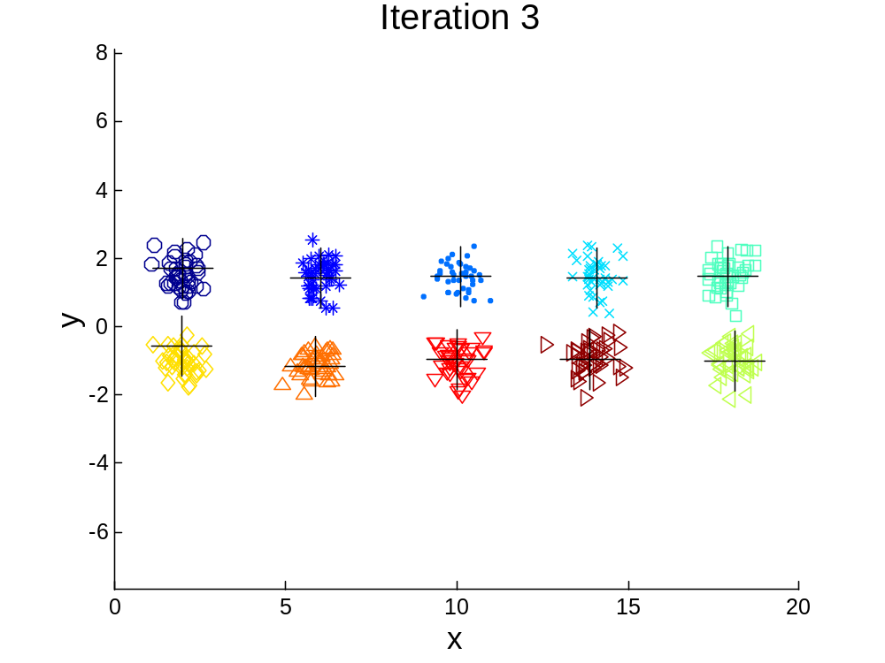

10 Clusters Example
Starting with two initial centroids in one cluster of each pair of clusters

Slide 64
10 Clusters Example
Starting with two initial centroids in one cluster of each pair of clusters

Slide 65
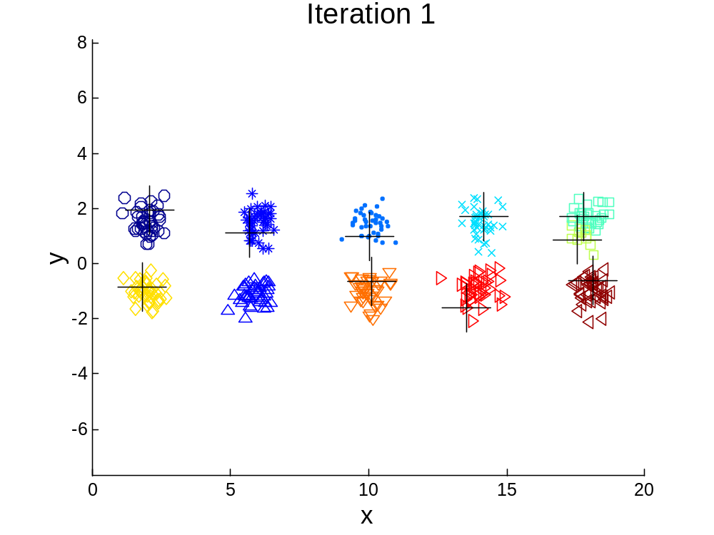



10 Clusters Example
Starting with some pairs of clusters having three initial centroids, while other have only one.

Slide 66
10 Clusters Example
Starting with some pairs of clusters having three initial centroids, while other have only one.

Slide 67
Solutions to Initial Centroids Problem
Multiple runs
  Helps, but probability is not on your side
Sample and use hierarchical clustering to determine initial centroids

Slide 68
Solutions to Initial Centroids Problem
Select more than k initial centroids and then select among these initial centroids
  Select most widely separated
    can select outliers, too
Post-processing
Bisecting K-means
  Not as susceptible to initialization issues

Slide 69
Additional Issues: Handling Empty Clusters
Basic K-means algorithm can yield empty clusters
Several strategies
  Choose the point that contributes most to SSE
  Choose a point from the cluster with the highest SSE
  If there are several empty clusters, the above can be repeated several times.

Slide 70
Updating Centers Incrementally
In the basic K-means algorithm, centroids are updated after all points are assigned to a centroid
An alternative is to update the centroids after each assignment (incremental approach)
  Each assignment updates zero or two centroids
  More expensive
  Introduces an order dependency!
  Never gets an empty cluster
  Can use “weights” to change the impact

Slide 71
Pre-processing and Post-processing
Pre-processing
  Normalize the data
  Eliminate outliers
Post-processing
  Eliminate small clusters that may represent outliers
  Split ‘loose’ clusters, i.e., clusters with relatively high SSE
  Merge clusters that are ‘close’ and that have relatively low SSE

Slide 72

Bisecting K-means
Bisecting K-means algorithm
  Variant of K-means that can produce a partitional or a hierarchical clustering

Slide 73
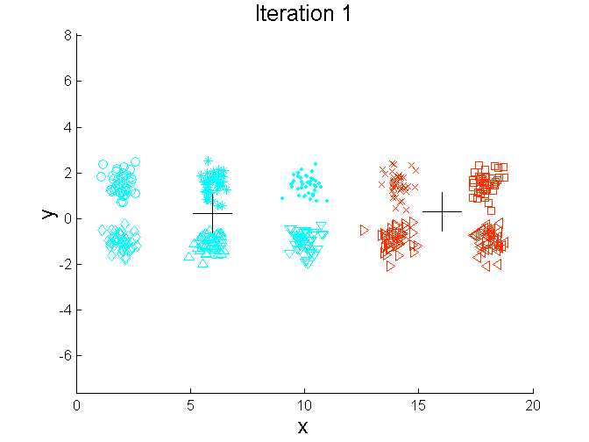
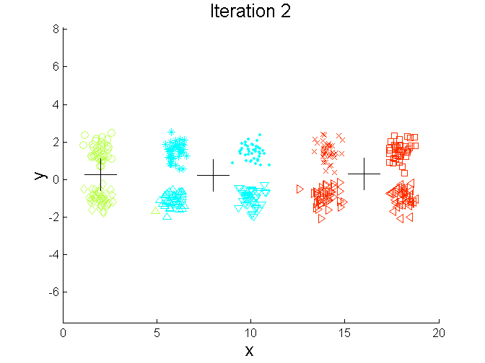
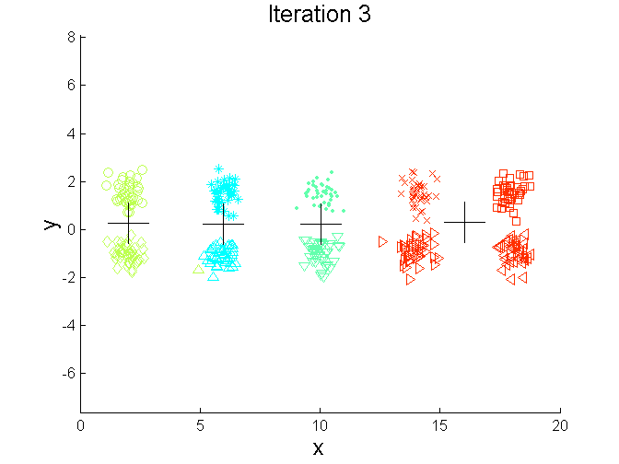
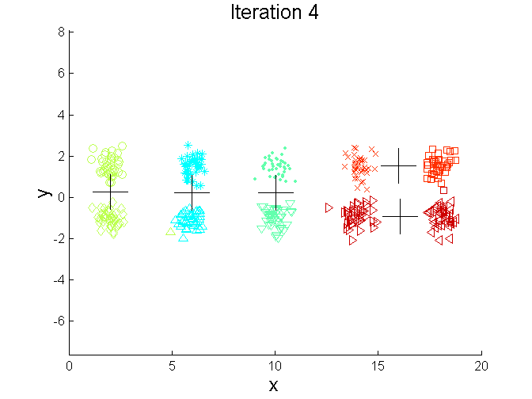
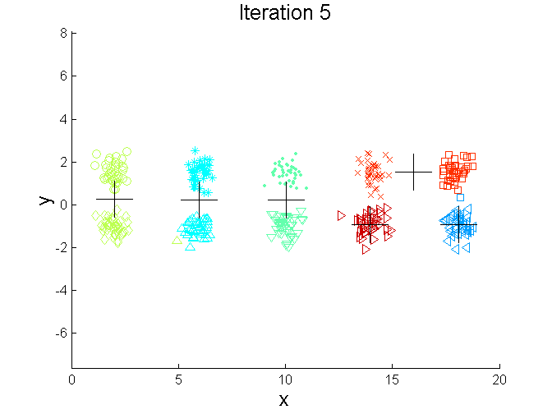
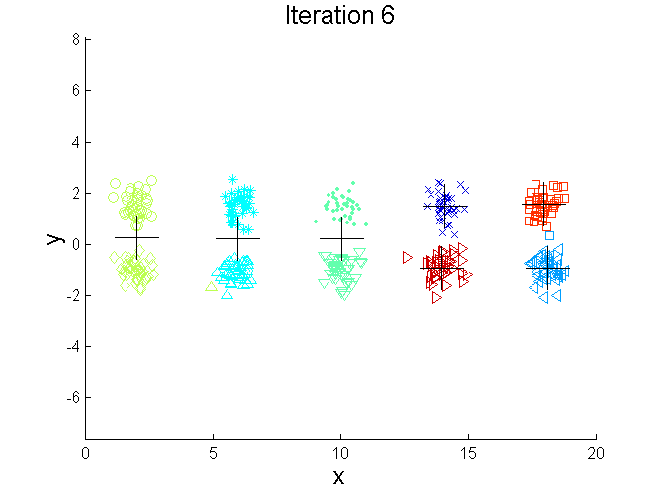
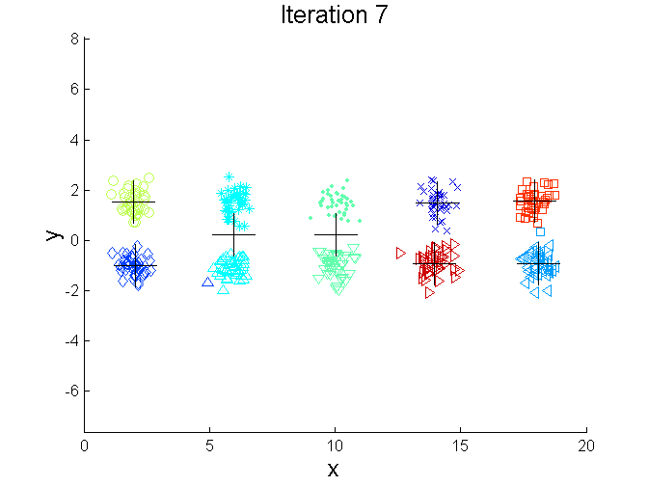
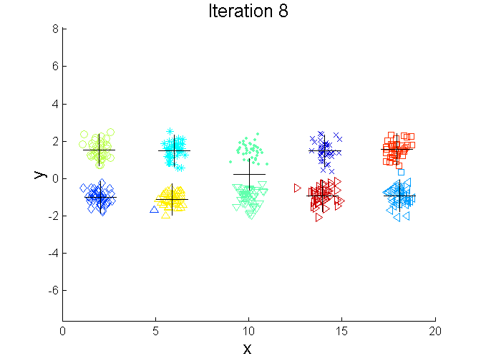
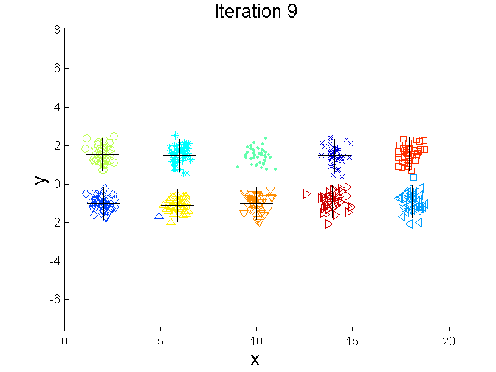
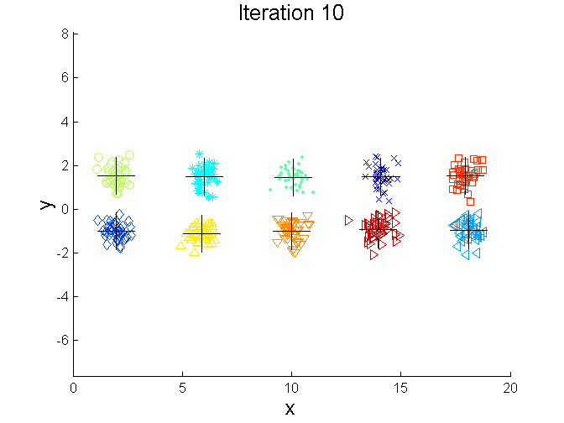
Bisecting K-means Example

Slide 74
Bisecting k-means as an initialization for another k-means run
bisecting k-means
  bisects individual clusters
  finds local minima of SSE
  usually does not provide optimal clustering

Slide 75
Bisecting k-means as an initialization for another k-means run
bisecting k-means
  bisects individual clusters
  finds local minima of SSE
  usually does not provide optimal clustering
final centroids from bisecting k-means can be used as initial centroids of a global k-means run

Slide 76
Limitations of K-means
K-means has problems when clusters are of differing
  Sizes
  Densities
  Non-globular shapes
K-means has problems when the data contains outliers.

Slide 77


Limitations of K-means: Differing Sizes
Original Points
K-means (3 Clusters)

Slide 78


Limitations of K-means: Differing Density
Original Points
K-means (3 Clusters)

Slide 79


Limitations of K-means: Non-globular Shapes
Original Points
K-means (2 Clusters)

Slide 80

Overcoming K-means Limitations
Original Points K-means Clusters
One solution is to use many clusters.
  Find parts of clusters, but need to put together.

Slide 81
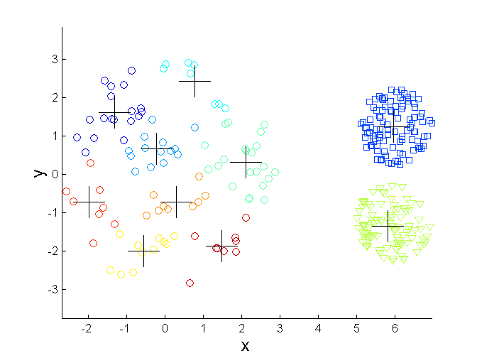
Overcoming K-means Limitations
Original Points K-means Clusters

Slide 82
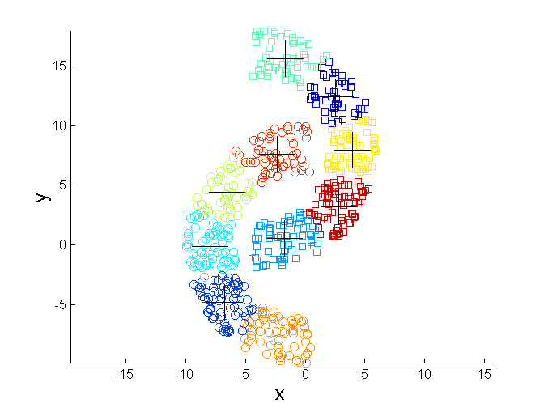
Overcoming K-means Limitations
Original Points K-means Clusters

